Slide 1
An Introduction to Software Engineering
Session 04
Course : COMP6100/Software Engineering
Effective Period : Desember 2017

Slide 2
Sommerville, I. (2011), Software Engineering 9th ed, Pearson, Addison Wesley United states of America, ISBN 13 : 978 0 13 705346 9. Chapter 1
Acknowledgement

Slide 3
LO 1 : Describe the concepts of software process models and the opportunity for potential business project
Learning Objectives

Slide 4
Contents
Software Engineering
Software Costs
FAQs about Software Engineering
What are the Costs of Software Engineering?
What are Software Engineering Methods?
What is CASE (Computer-Aided Software Engineering)
What are the Attributes of Good Software?
What are the Key Challenges Facing Software Engineering?
Professional and Ethical Responsibility

Slide 5
Software Engineering
The economies of ALL developed nations are dependent on software.
More and more systems are software controlled
Software engineering is concerned with theories, methods and tools for professional software development.
Expenditure on software represents a
significant fraction of GNP in all developed countries.

Slide 6
Software Costs
Software costs often dominate computer system costs. The costs of software on a PC are often greater than the hardware cost.
Software costs more to maintain than it does to develop. For systems with a long life, maintenance costs may be several times development costs.
Software engineering is concerned with cost-effective software development.

Slide 7
FAQs about Software Engineering
What is software?
What is software engineering?
What is the difference between software engineering and computer science?
What is the difference between software engineering and system engineering?
What is a software process?
What is a software process model?

Slide 8
FAQs about Software Engineering
What is software?
Computer programs and associated documentation such as requirements, design models and user manuals.
Software products may be developed for a particular customer or may be developed for a general market.
Software products may be
  Generic - developed to be sold to a range of different customers e.g. PC software such as Excel or Word.
  Bespoke (custom) - developed for a single customer according to their specification.
New software can be created by developing new programs, configuring generic software systems or reusing existing software.

Slide 9
FAQs about Software Engineering
What is software engineering?
Software engineering is an engineering discipline that is concerned with all aspects of software production.
Software engineers should adopt a systematic and organised approach to their work and use appropriate tools and techniques depending on the problem to be solved, the development constraints and the resources available.

Slide 10
FAQs about Software Engineering
What is the difference between software engineering and computer science?
Computer science is concerned with theory and fundamentals; software engineering is concerned with the practicalities of developing and delivering useful software.
Computer science theories are still insufficient to act as a complete underpinning for software engineering (unlike e.g. physics and electrical engineering).

Slide 11
FAQs about Software Engineering
What is the difference between software engineering and system engineering?
System engineering is concerned with all aspects of computer-based systems development including hardware, software and process engineering. Software engineering is part of this process concerned with developing the software infrastructure, control, applications and databases in the system.
System engineers are involved in system specification, architectural design, integration and deployment.

Slide 12
FAQs about Software Engineering
What is a software process?
A set of activities whose goal is the development or evolution of software.
Generic activities in all software processes are:
  Specification - what the system should do and its development constraints
  Development - production of the software system
  Validation - checking that the software is what the customer wants
  Evolution - changing the software in response to changing demands.

Slide 13
FAQs about Software Engineering
What is a software process model?
A simplified representation of a software process, presented from a specific perspective.
Examples of process perspectives are
  Workflow perspective - sequence of activities;
  Data-flow perspective - information flow;
  Role/action perspective - who does what.
Generic process models
  Waterfall;
  Iterative development;
  Component-based software engineering.

Slide 14
What are the Costs of Software Engineering?
Roughly 60% of costs are development costs, 40% are testing costs. For custom software, evolution costs often exceed development costs.
Costs vary depending on the type of system being developed and the requirements of system attributes such as performance and system reliability.
Distribution of costs depends on the development model that is used.

Slide 15
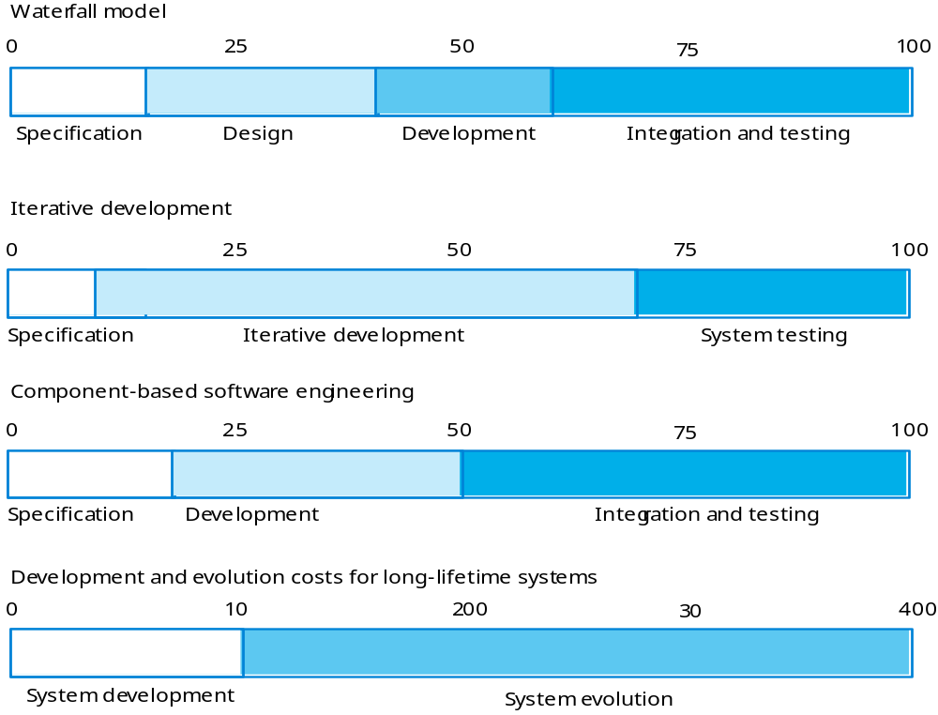
What are the Costs of Software Engineering?
Activity cost distribution

Slide 16
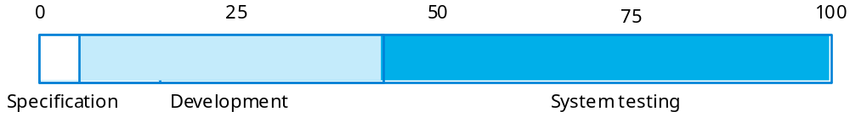
What are the Costs of Software Engineering?
Product development costs

Slide 17
What are Software Engineering Methods?
Structured approaches to software development which include system models, notations, rules, design advice and process guidance.
Model descriptions
  Descriptions of graphical models which should be produced;
Rules
  Constraints applied to system models;
Recommendations
  Advice on good design practice;
Process guidance
  What activities to follow.

Slide 18
What is CASE (Computer-Aided Software Engineering)
Software systems that are intended to provide automated support for software process activities.
CASE systems are often used for method support.
Upper-CASE
  Tools to support the early process activities of requirements and design;
Lower-CASE
  Tools to support later activities such as programming, debugging and testing.

Slide 19
What are the Attributes of
Good Software?
The software should deliver the required functionality and performance to the user and should be maintainable, dependable and acceptable.
Maintainability
  Software must evolve to meet changing needs;
Dependability
  Software must be trustworthy;
Efficiency
  Software should not make wasteful use of system resources;
Acceptability
  Software must accepted by the users for which it was designed. This means it must be understandable, usable and compatible with other systems.

Slide 20
What are the Key Challenges Facing Software Engineering?
Heterogeneity, delivery and trust.
Heterogeneity
  Developing techniques for building software that can cope with heterogeneous platforms and execution environments;
Delivery
  Developing techniques that lead to faster delivery of software;
Trust
  Developing techniques that demonstrate that software can be trusted by its users.

Slide 21
Professional and
Ethical Responsibility?
Software engineering involves wider responsibilities than simply the application of technical skills.
Software engineers must behave in an honest and ethically responsible way if they are to be respected as professionals.
Ethical behaviour is more than simply upholding the law.

Slide 22
Professional and
Ethical Responsibility
Issues of professional responsibility
Confidentiality
  Engineers should normally respect the confidentiality of their employers or clients irrespective of whether or not a formal confidentiality agreement has been signed.
Competence
  Engineers should not misrepresent their level of competence. They should not knowingly accept work which is outwith their competence.

Slide 23
Professional and
Ethical Responsibility
Issues of professional responsibility
Intellectual property rights
  Engineers should be aware of local laws governing the use of intellectual property such as patents, copyright, etc. They should be careful to ensure that the intellectual property of employers and clients is protected.
Computer misuse
  Software engineers should not use their technical skills to misuse other people’s computers. Computer misuse ranges from relatively trivial (game playing on an employer’s machine, say) to extremely serious (dissemination of viruses).

Slide 24
Exercises
Provide a number of examples (both positive and negative) that indicate the impact of software on our society.
Is software engineering applicable when webApps are built? If so, how might it be modified to accommodate the unique characteristics of WebApps?
As software becomes more pervasive, risks to the public (due to faulty programs) become an increasingly significant concem. Develop a doomsday but realistic scenario in which the failure of a computer program could do great harm (either economic or human) . Provide a number of examples (both positive and negative) that indicate the impact of software on our society.

Slide 25
References
Sommerville, I. (2011), Software Engineering 9th ed, Pearson, Addison Wesley United states of America, ISBN 13 : 978 0 13 705346 9.
What can we learn from software engineering and why?, http://www.youtube.com/watch?v=8kG15VoNxhc
How to Reduce Cost of Software Development, http://www.youtube.com/watch?v=gKeka3zn198

Slide 26
Q & A

